Slide 1

DOCUMENTATION FINAL PROJECT
TDM2123: Publishing on the World Wide Web
RECIPES & COOKING BL0G (BAKING)
STUDENT’S NAME / ID | : | 1) NUR SYIFA INSYIRAH BINTI MOHAD TAIB / IPJ200310295
CLASS | : | DMM0303
LECTURER’S NAME | : | ENCIK MUHAMMAD SYAFIQ BIN HARON
DATE OF SUBMISSION | : | 18 JUNE 2021

Slide 2
PURPOSE STATEMENT
Primary :
to share more recipes with baking enthusiasm
to ensure users get interesting experiences and ideas from this website
to attract more people to love baking
Secondary :
to make the audience who is scrolling through this website happy and stress-free
expose them to baking skills and recipes, as well as guidance on how to choose and use baking equipment
Objectives :
Include images of the recipes
Include videos on how to design a cake
Giving ingredients & instructions of recipes

Slide 3
TARGET AUDIENCE
DEMOGRAPHIC
Local and outsider
70% female and 30% male
Age 15 and above
Children and adults
Psychographic
Love in baking
Love to learn new recipes
Interested in cakes, cupcakes and cookies
People who interested in challenging things or bakery business

Slide 4
PROJECT PROFILE
After some thought and research, I've decided to choose recipes and cooking blogs (baking) as my website topics because there is a lot of information to learn. In this project, I'd like to share baking recipes with all baking enthusiasts.
GROUP PROFILE :
Task :
1. NUR SYIFA INSYIRAH BINTI MOHAD TAIB
Website Design
Documentation -Introduction -Project Profile -Purpose Statement -Ideation - Website Content -Ideation - Primary navigation -Ideation - Mindmap -Navigation Structure -Website Content -Website Storyboard -Target Audience -Presentation

Slide 5
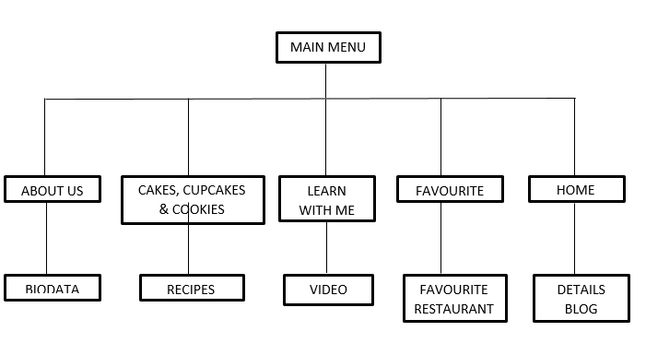
NAVIGATION STRUCTURE

Slide 6
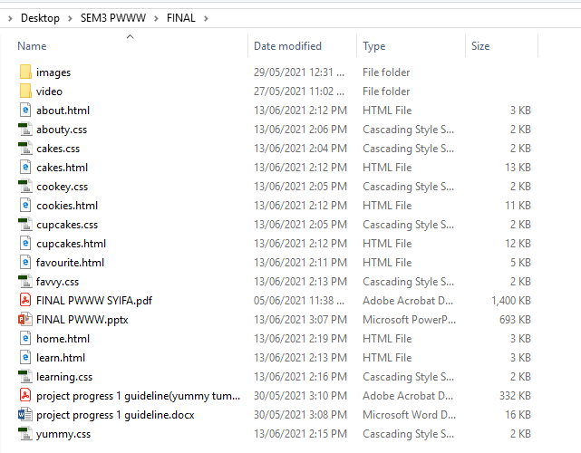
FILE ORGANISATION

Slide 7
THANK YOU !

